Slide 1
How to make a custom block in EV3 Classroom
By Avek Dongol

Slide 2
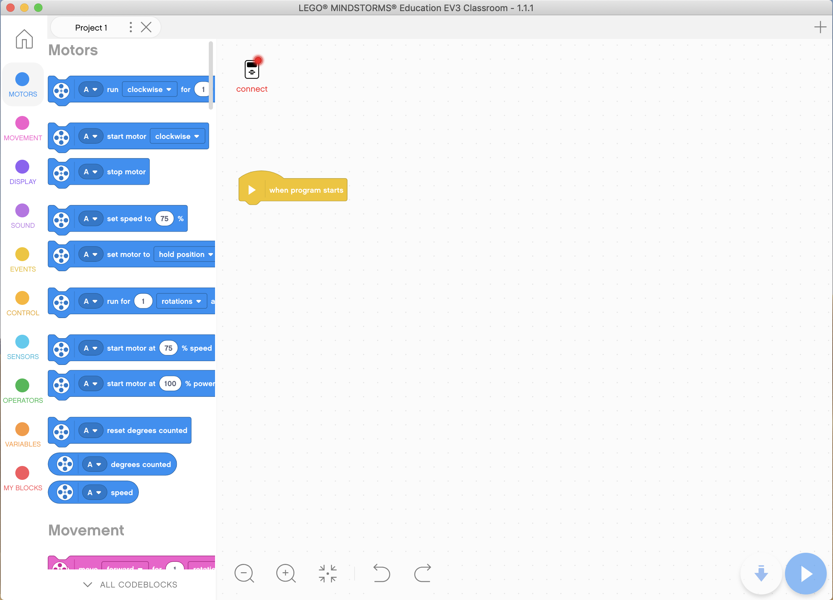


HOW TO MAKE A CUSTOM BLOCK IN EV3 CLASSROOM

Slide 3
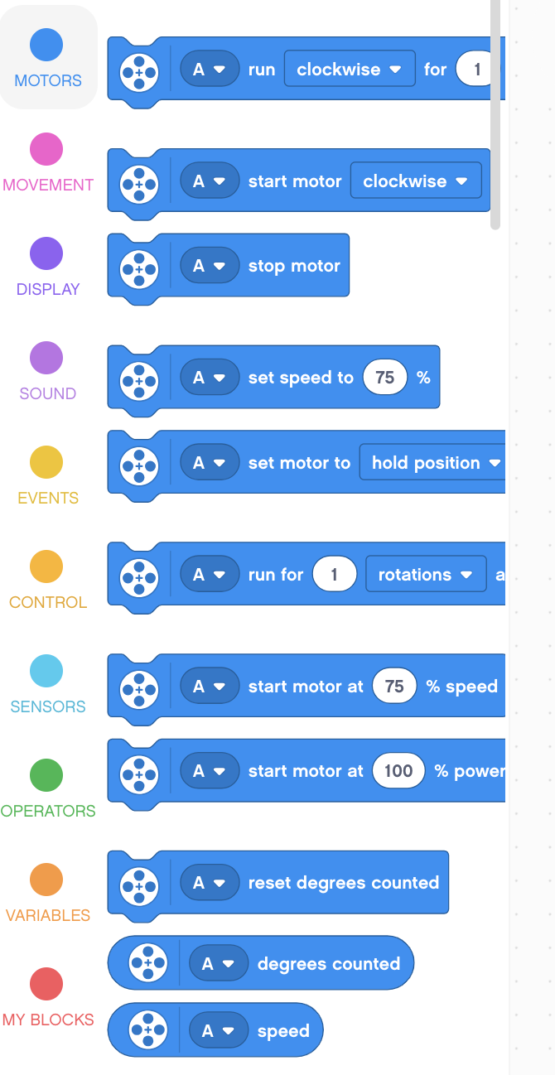
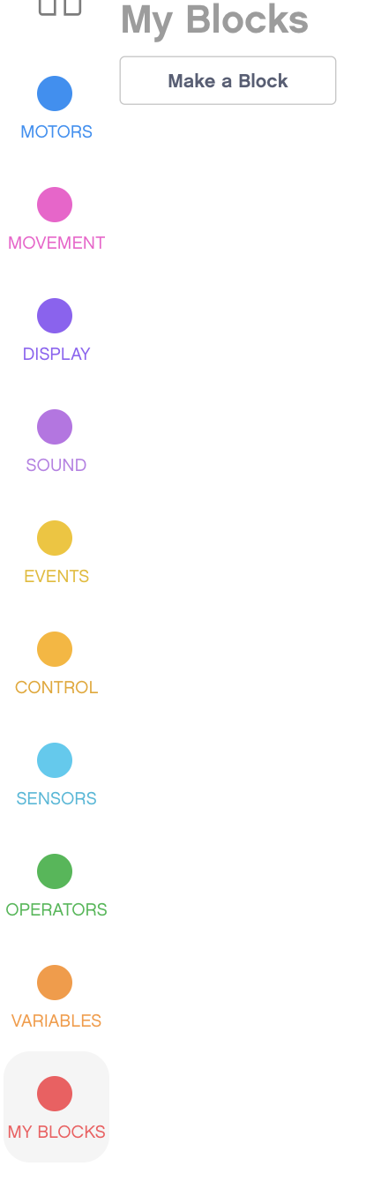


HOW TO MAKE A CUSTOM BLOCK IN EV3 CLASSROOM
Go to the “My Blocks” menu. There is a panel on the left of the window where there is a shortcut to the my blocks menu. (click to see next step)
Doing so will lead to what is on the right. Notice the “make a block” button. Press the button.
The My Blocks Menu

Slide 4
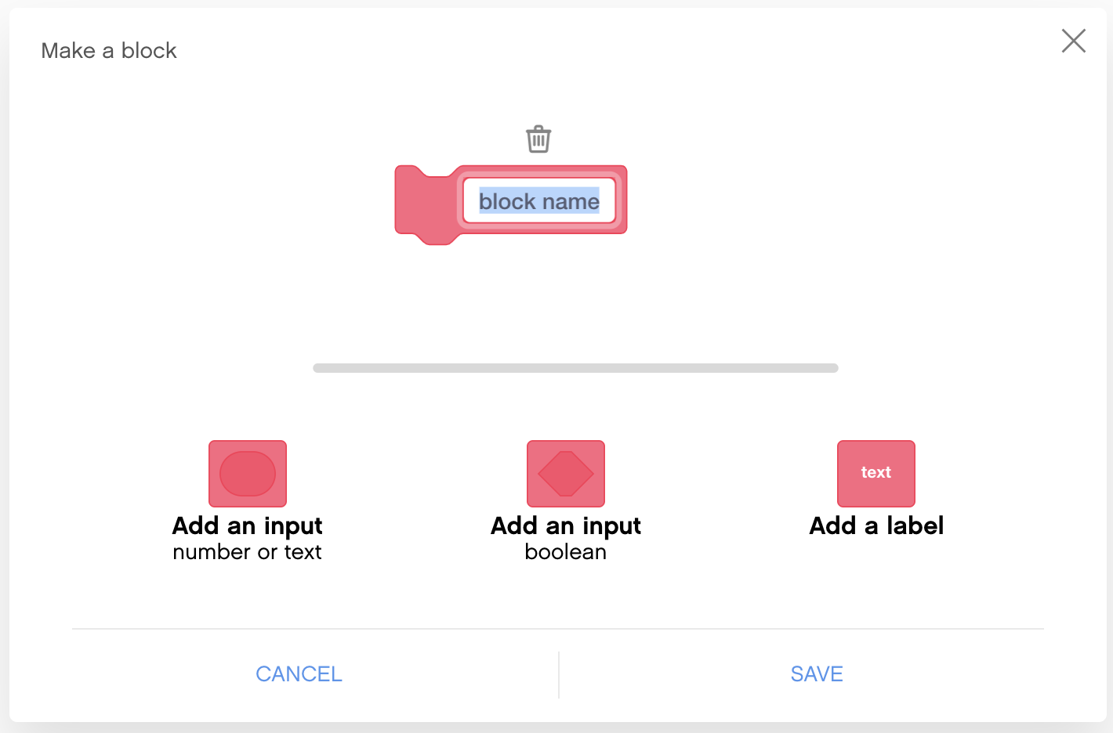
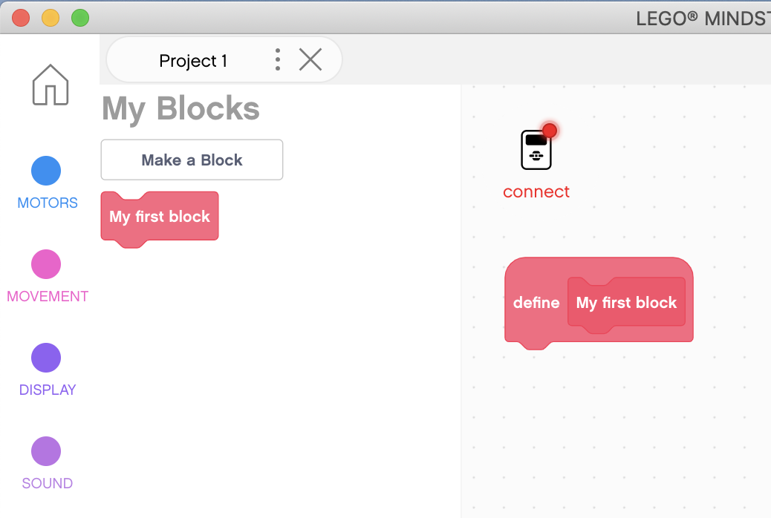


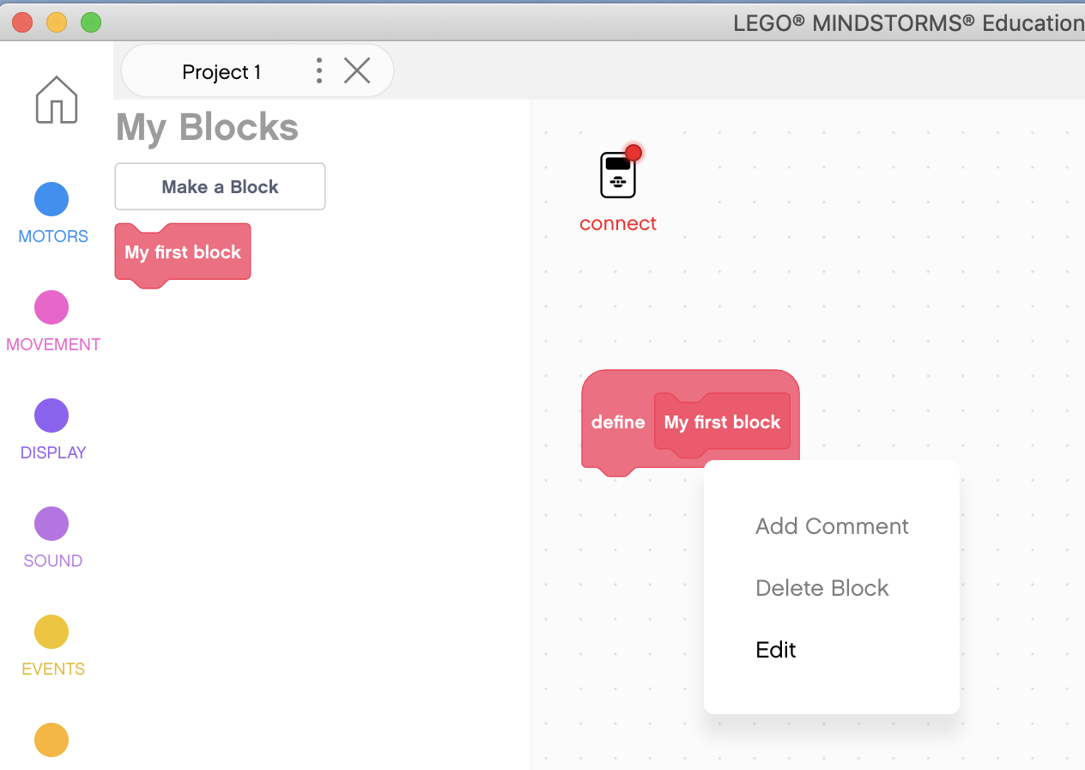

HOW TO MAKE A CUSTOM BLOCK IN EV3 CLASSROOM
Tada! The block appears in the “My Blocks” category, and there is a define block where you put the block definition.
I will rename my block “My first block”.
Your block appears here!
That will make the popup window on the right. You can change the names of labels, add labels and parameters, etc. Once you are done, press the save button.
After the block is defined, right-click and then click edit to edit the block.

Slide 5
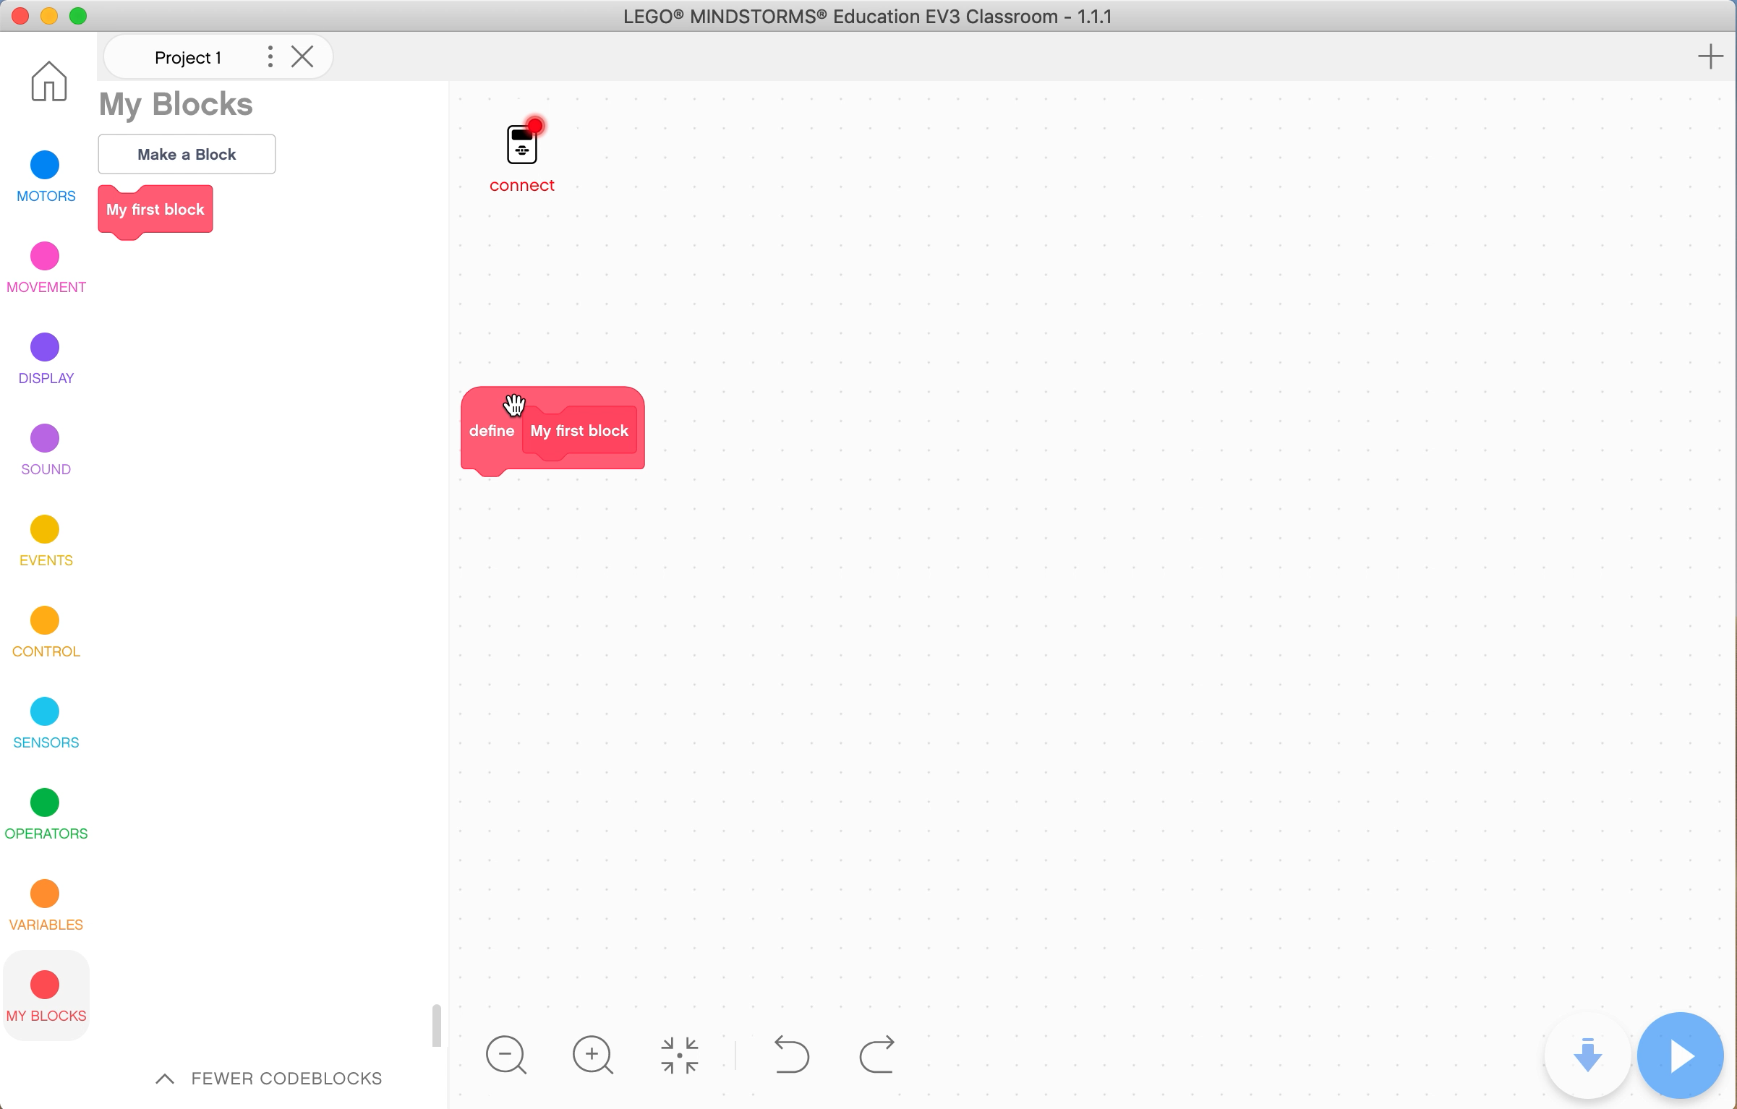
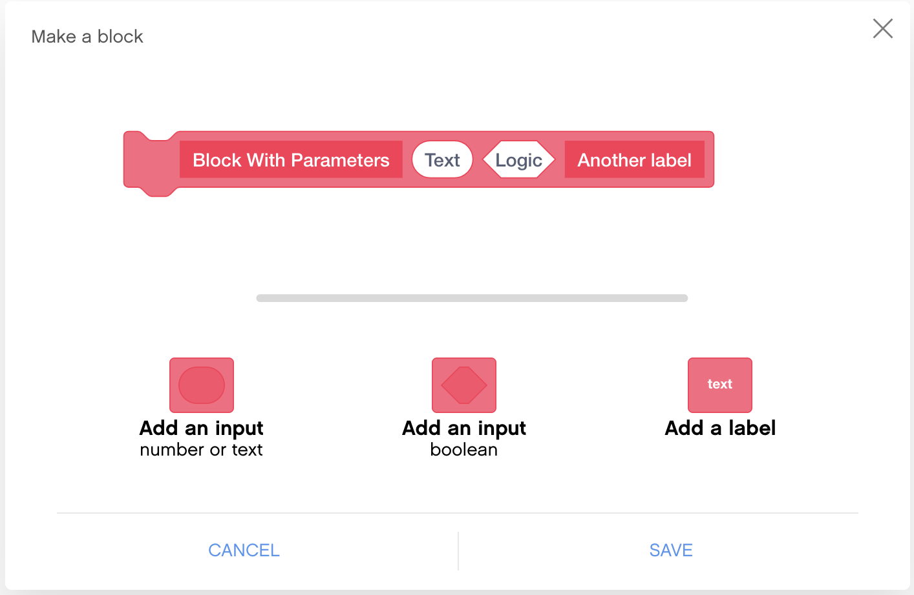

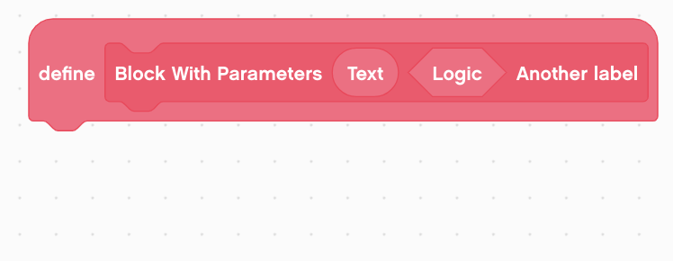
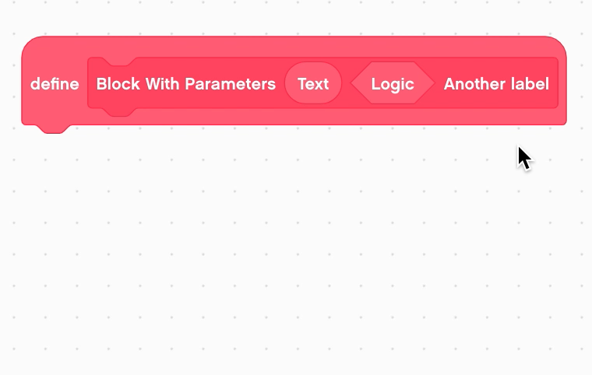
HOW TO MAKE A CUSTOM BLOCK IN EV3 CLASSROOM
There are three buttons above the bottom two: the first is to add a number/text input, the second to add a logic input, and the third is to add a label.
Demo
Once you press save, the define block will look like what is on the right. You can actually drag the inputs out, as shown in the video on the right.

Slide 6
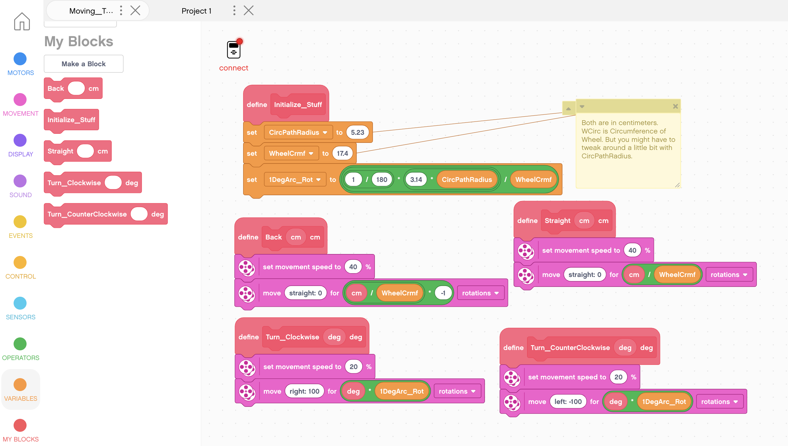
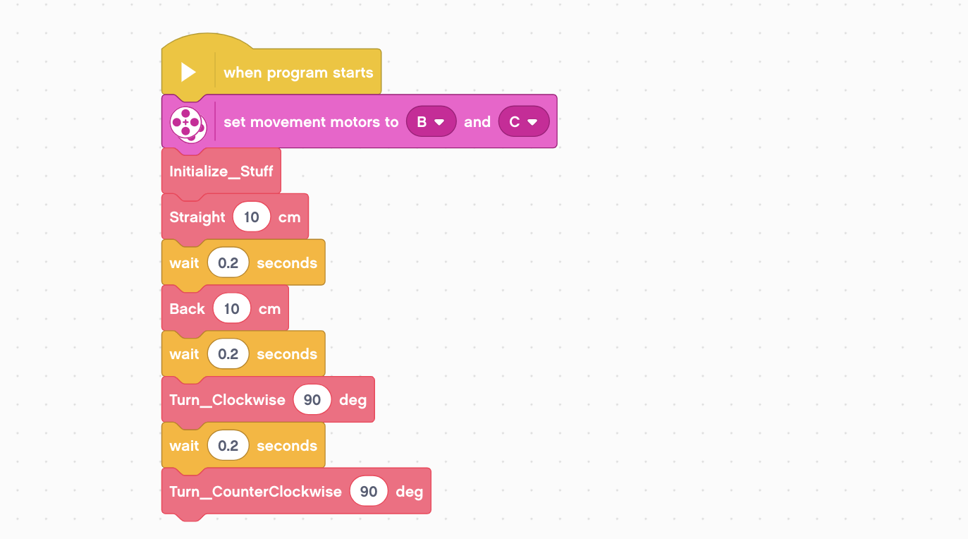
HOW TO MAKE A CUSTOM BLOCK IN EV3 CLASSROOM
This is an application of custom blocks. In this picture, there are definitions for all movements (like going backwards, forwards, and turning).
Input
Label
In this picture, the custom blocks are used. Not only do they make the code less repetitive, they also make the code easier to read.
Input

Slide 7
HOW TO MAKE A CUSTOM BLOCK IN EV3 CLASSROOM
Thank You
Any Questions?

